Slide 1
Fabric Real-Time Intelligence: L400 Advanced Training
Paris, 22-24 September 2025

Slide 2
Facilities
Understand Real-Time Intelligence’s strategic role in Microsoft Fabric
Wifi: Msftguest
Eventcode: msevent6627
Restrooms: Hallway To The Left, In The Middle Of The Hallway, To The Right.
Lunch will be in the canteen. Coffee and refreshments available in the café area
Lunch Break (12:30 – 13:30)
Coffee Breaks (11:00 - 11:10 & 15:30 – 15:40)

Slide 3
What You Will Learn
Understand Real-Time Intelligence’s strategic role in Microsoft Fabric
Understand Real-time Intelligence’s Strategic Role In Microsoft Fabric
Identify Core Components: Eventstream, Activator, Eventhouse
Grasp The Architectural Foundations Of Real-time Intelligence
Explore Use Cases And Implementation Considerations

Slide 4
Agenda
Topic
Timing
Day 1
Introduction, objectives of this training and expectations from you, Architecture Patterns, Real-Time Hub, Connectors & Ingestion
09:00 - 15:00
Real-Time Intelligence Hack
15:00 – 17:30
Day 2
Data Modelling, Analytics and AI, Visualization, Security, Networking
09:00 - 15:00
Real-Time Intelligence Hack (continued…)
15:00 – 17:30
Day 3
Rules, Actions, CI/CD, Cost
09:00 - 12:00
Real-Time Intelligence Hack (continued…)
13:00 – 17:30

Slide 5
Objectives of this training
Equip our field and partners with the advanced knowledge of the tech stack of Real-Time Intelligence
Forum for partners to learn directly from Product Managers and Fabric CAT Program Managers
Ask questions, seek clarifications, dive deep into challenges, scenarios, use cases, situations that you have experienced

Slide 6
Expectations From You
Ask questions, participate, engage
Provide constructive, targeted feedback on improving this training
Contribute to enhancing this content
Derive your internal training modules based on this
Stay connected and grow the Real-Time Intelligence Community

Slide 7
Architectures and Patterns

Slide 8

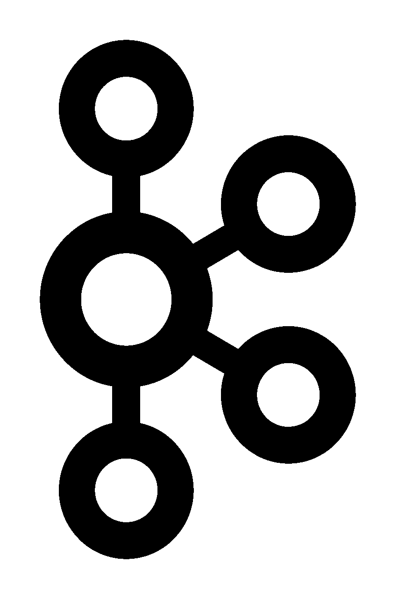







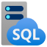
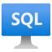
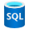











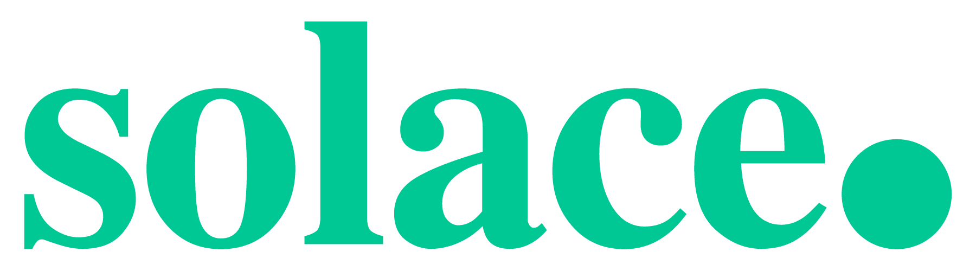




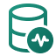

Real-Time Intelligence in Microsoft Fabric
Ingestion
Analytics
Digital Twin Builder
Dashboards
Rules
Actions
AI
Real-Time Hub
OneLake
Connectors
Notes:
Well, I have a very good news! RTI is expanding its capabilities to help bridge the physical and digital world with the new digital twin builder.
We heard from many of our customers the need to bridge the digital and physical and leverage this data in near real time. And all with one cohesive solution.
Let’s see it in action

Slide 9


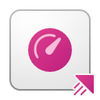
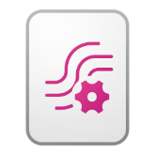








Real-Time Intelligence Architecture Overview
Connect
Ingest & Process
Analyse & Transform
Train & Score
Visualize & Act
Get assisted & Interact
Power BI Report
Data Agent
Real-Time Dashboard
Copilot
Eventstream
KQL Queryset
Eventhouse
Activator
Consume
ML model
Custom Endpoint
REST API
Lakehouse
OneLake
Notes:
-Bi-drectional shortcuts
-Consume data with REST API and Custom Endpoint

Slide 10


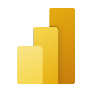










Energy Management
Ingest & Process
Analyze & Transform
Model &
Contextualize
Train & Score
Visualize & Act
Get Assisted & Interact
Wind Farm
Eventstream
PBI Report
Activator
Weather
Eventstream
Real-Time Dashboard
Eventhouse
MQTT
Eventstream
Queryset
ERP
Data Factory
OneLake
Digital Twin Builder
ML model
Notes:
However, that’s not all. As I have said, AI is an essential pillar for your business.
Let’s dive deeper into it…

Slide 11



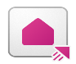


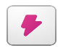



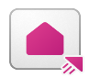

Real Time Intelligence
Ingest & process
Analyze & transform
Visualize and Activate
A work order team loads vehicle telemetry in real-time into Fabric RTI
A finance team maintains financial reporting data in a CRM
Work Order data is sent via Kafka topics to an event stream in the work order workspace
An inventory team manages the stock across all products in the organization in a SQL Server database
An eventhouse uses table update policies to load and process data
Finance mirrors the data to OneLake and transforms it with CRM data using either SQL or Spark
Inventory team loads data to Eventhouse storing up to the minute inventory data
An Eventhouse shortcut is created back to the Work Order team to leverage inventory data in real-time
A real-time dashboard provides an up-to-date view of the work order system along with a map showing the closest available technician
An activator is triggered which creates a dispatch to the nearest available technician
A Power BI report runs within Finance that reconciles work orders and CRM data for monthly reporting. Finance creates an activator which creates the invoice upon work order dispatch
The inventory team has a Power BI report running showing up to the minute inventory information, and an activator that triggers alerts when inventory gets low
1
5
IoT Hub
Eventstream
3
Eventhouse
8
9
10
Kafka
Eventstream
Eventhouse
Real-Time Dashboard
Activator
11
2
6
PBI Report
CRM
Data Factory
OneLake
Lakehouse
7
Activator
4
7
12
Inventory
Eventstream
Eventhouse
Activator
PBI Report
11
Notes:
Products are going via rigorous testing cycles during development with test session generating millions of events in millisecond granularity.
Tests runs are ad hoc based, they can be executed multiple times a day, or once a week, depends on the need. The tests are generated data in very high granularity and in sharp spikes so the system is expected to be able to handle those spikes and high granularity.
2. Tests events are streamed and processed in real time via Eventstream to Eventhouse with sub-second latency. Latency is very critical for the ability to identify issues as the test runs, in real time, so low latency is advisable
3. Faceted data (Ex. Weather conditions, test site enviroment IoT, etc.) ,mirrored into Fabric OneLake test values and results can be highly affected by environmental factors, like weather,the test area environmental factors (humidity, pressure, etc.) there is also significant metadate on each component and device detailed the spec, thresholds, etc.
4. test events are enriched on-the-fly with the faceted data, providing curreted and enriched data set ready for analytics. Enriching the events with the dimensional data provides us full curated view of the test events that can easily used for analytics
5. Dashboards presenting test cycles progress and result with high granularity in real time. As mentioned above , high granularity and latency is critical during test cycles, RTA dashboards allows to see the data in high granularity and drill into components and specific Tags while the test is actively running
6. Build and train ML models for test analytics and score them in real time during test runs. Historical test results contains very valuable data for training models, learning from all of the runs and results. Then using those trained models during test cycles for better test results
7. Notify in real time on test anomalies and results with data activator

Slide 12

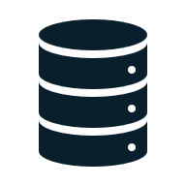
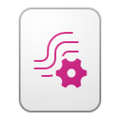


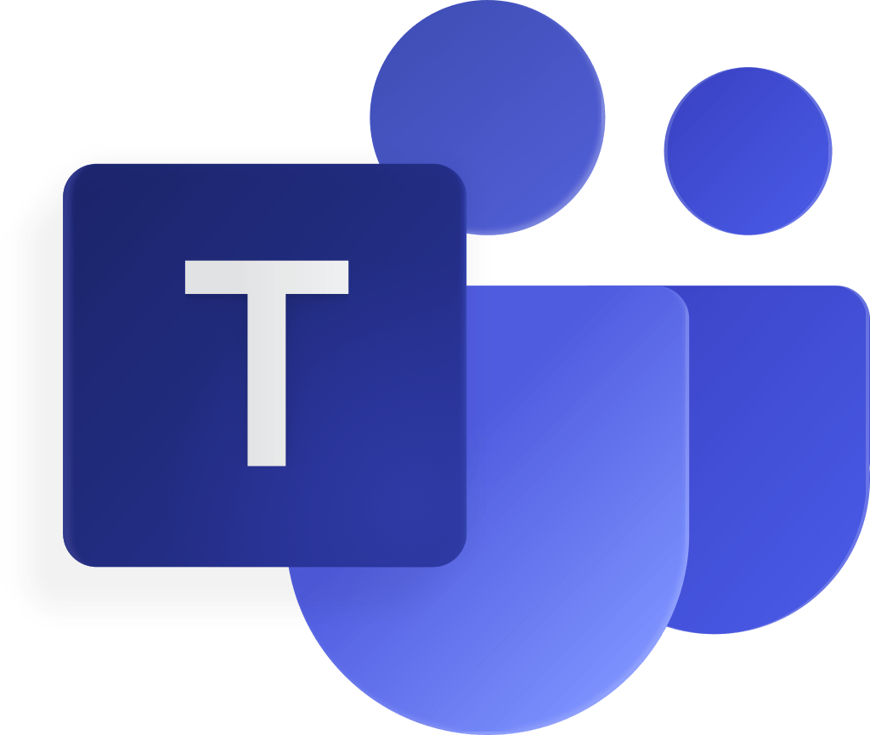
Pub-Sub Stream Processor
Activator
Real-Time Dashboard
Producer
z
Consumer
Eventhouse
Eventstream
Eventstream
Raw Data
Process Data
Kusto Query
Activator
Teams

Slide 13
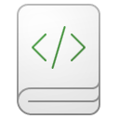


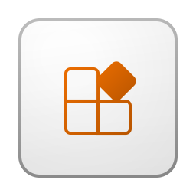
Database CDC Processing
Fabric
3
4
5
Activator
Teams
Spark CDC Merging
Lakehouse
Source
1
2
Eventhouse
DB CDC
Eventstream
Semantic Model
Report
OrgApp
Raw Data
CDC Events
Real-Time Dashboard
6
Kusto Query
Activator
Teams
Notes:
Eventstream at the moment connects trough the public endpoint of the Source DB. If the source system is behind a firewall, we can whitelist the IP of the Eventstream. (Look at Connect to Streaming Sources in Virtual Network or On Premises with Eventstream - Microsoft Fabric | Microsoft Learn)
All the events are sent to Eventhouse to process them and make them available in OneLake to be used on Spark to do the CDC Merging.
We can react on data directly on the Eventstream with Activator
Process the events in OneLake to merge the CDC events with Spark
Make the changes in the Lakehouse to replicate the Database data
We can react on the events in the Eventhouse to do more batching Activator process

Slide 14
Fabric Platform Observability
Heartbeat
Reports
GW Configuration
Activator
Teams
OPDG
DirectQuery Reports
Eventstream
Eventhouse
Semantic Model
Report
OrgApp
Real-Time Dashboard
Capacity Events
Scanner API / Audit Logs Extraction /
Other APIs
Activator
Teams
Kusto Query
Credits: Edgar Cotte aka.ms/FabricPlatformMonitoringRTI

Slide 15






Sentinel Logs Offload Pattern
Security
Advantages
Long term retention
Queryable cold store
Cost optimal
Forensic analysis
Data ingestion
External table query
Cross query support
Inges additional data
Data science scenario
Data sovereignty & isolation
Data discovery
Data sharing
Native Git integration
Granular role-drive data access control
3 Month Retention
SIEM & SOAR
Frequent threat hunting
Current Investigation
Sentinel
Defender
XDR
Data Sources
Value Data
Log Analytics
Cross Service Query
SOC Analyst
Microsoft Fabric
Long term retention
Forensic analysis
Infrequent threat hunting
Custom ML models
Advance analytics scenario
Data sharing
Real-Time Intelligence
Full Scale Investigation
Analytics

Slide 16
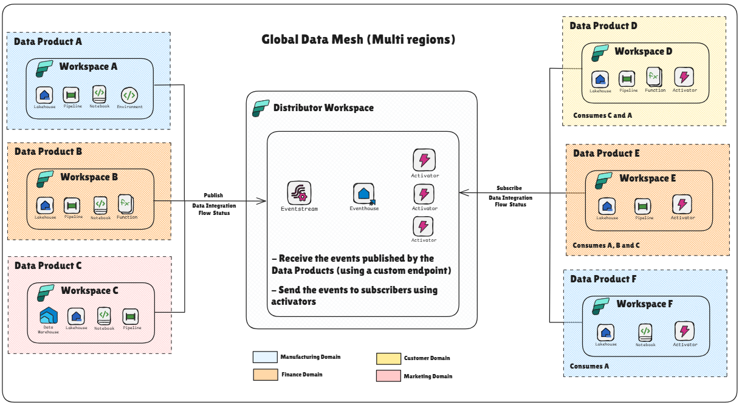
Data Product Synchronization Pattern
Credits: Stephane LUAP(8) MS Fabric - Data Products dependency challenge | LinkedIn

Slide 17
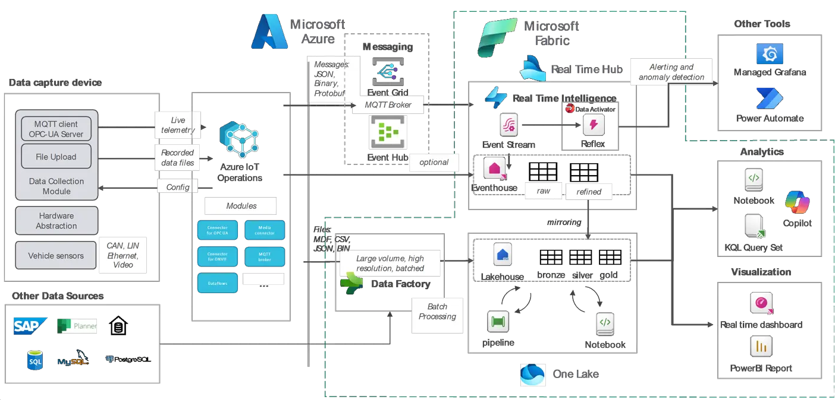
Smart Manufacturing
Credits: Florian Stein Real-Time Intelligence With Azure IoT & Microsoft Fabric
Credits: Stephane LUAP(8) MS Fabric - Data Products dependency challenge | LinkedIn

Slide 18
Hands on Lab

Slide 19
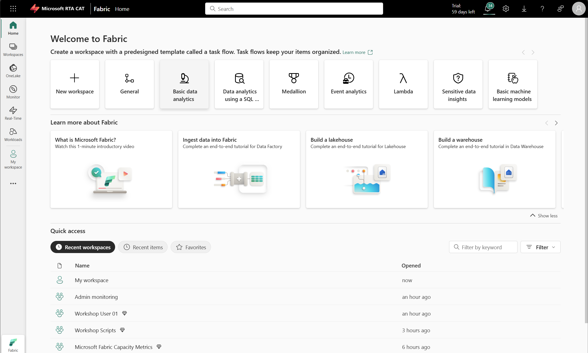
Lab environment
Open the lab at aka.ms/L400WorkshopHOL
Follow instructions in the instruction pane
Credential:
L400User{XXX}@mrtacat.onmicrosoft.com
Workshop1234!
WiFi Access: MSFTGUEST
Event Attendee Code: msevent6627
Notes:
Share the info as seen on slide

Slide 20
Real-Time hub

Slide 21
What You Will Learn In This Module
Understand Real-Time Intelligence’s strategic role in Microsoft Fabric
Learn how to discover different data sources in your environment using Real-Time hub.
Understand how Real-Time hub, in coordination with components like Eventstream, helps route the ingested data.
Determine how to configure the ingestion from a variety of data sources for consumption by other Real-Time Intelligence components.
Learn the integration points, performance considerations, and usage patterns for Real-Time hub.

Slide 22
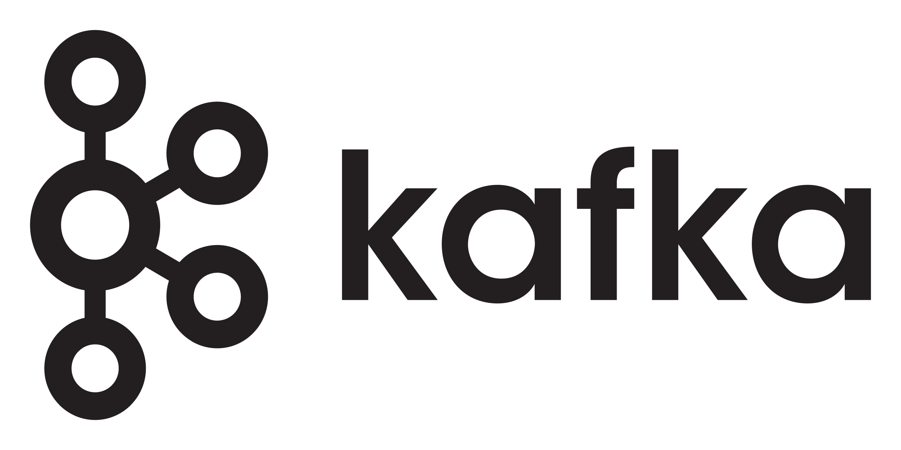

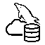

Real-Time hub
Connectors
Real-Time hub
Catalog
Endorsements
Data Exploration
Fabric Events
Data Visualization
Set Alert
Discoverable Microsoft Sources
Stream Profile
Stream Lineage
Notes:
Real-Time hub can serve as a “one-stop shop” for the various data sources you can ingest into Real-Time Intelligence, it is like a catalog where you see all the different connections for RTI in Fabric, where all data streams are exposed together with the tables of realtime data
So we can discover what we have in Fabric but also in Azure. That we you are able to see the different azure sources to which you have permission to, no need to ask for connection details.
Also, we`ll be able to discover endorsements or information protection classifications, along with alerts.
There are multiple types of ingestion that can be done via Real-Time hub
Schema Registry in Fabric Real-Time Intelligence is a centralized repository for managing and organizing data schemas. This feature provides a structured framework for defining, validating, and evolving schemas used in event-driven architectures, helping you improve data quality and maintain consistency across your real-time workflows.

Slide 23
Connectors

Slide 24
Real-Time Intelligence in Microsoft Fabric, comes with a various list of connectors to read data from different sources.
In general, two types of connectors exist in Microsoft Fabric for Real-Time Intelligence
Connectors for
Eventstream
Connectors for
Eventhouse
Connectors for Eventstream are the ones found in the “source” section of Eventstream and in the Real-Time hub.
Connectors for Eventhouse are built as adaptors to connect to other services.
Notes:
Evenstream lets you bring real-time events into Fabric, transform them, and then route them to various destinations. Eventstream is the foundational component for real-time data ingestion in Microsoft Fabric. It allows users to collect and process data from multiple sources, such as IoT devices, applications, and external event hubs.
Eventhouse is a high-performance, scalable storage solution designed specifically for event-driven data. It provides structured storage optimized for real-time analytics, ensuring that data remains accessible for downstream processing. Eventhouse is optimized for large-scale event storage and retrieval, supports time-series and event-based analytics, and integrates seamlessly with other Fabric components for querying and reporting.

Slide 25






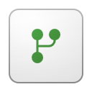

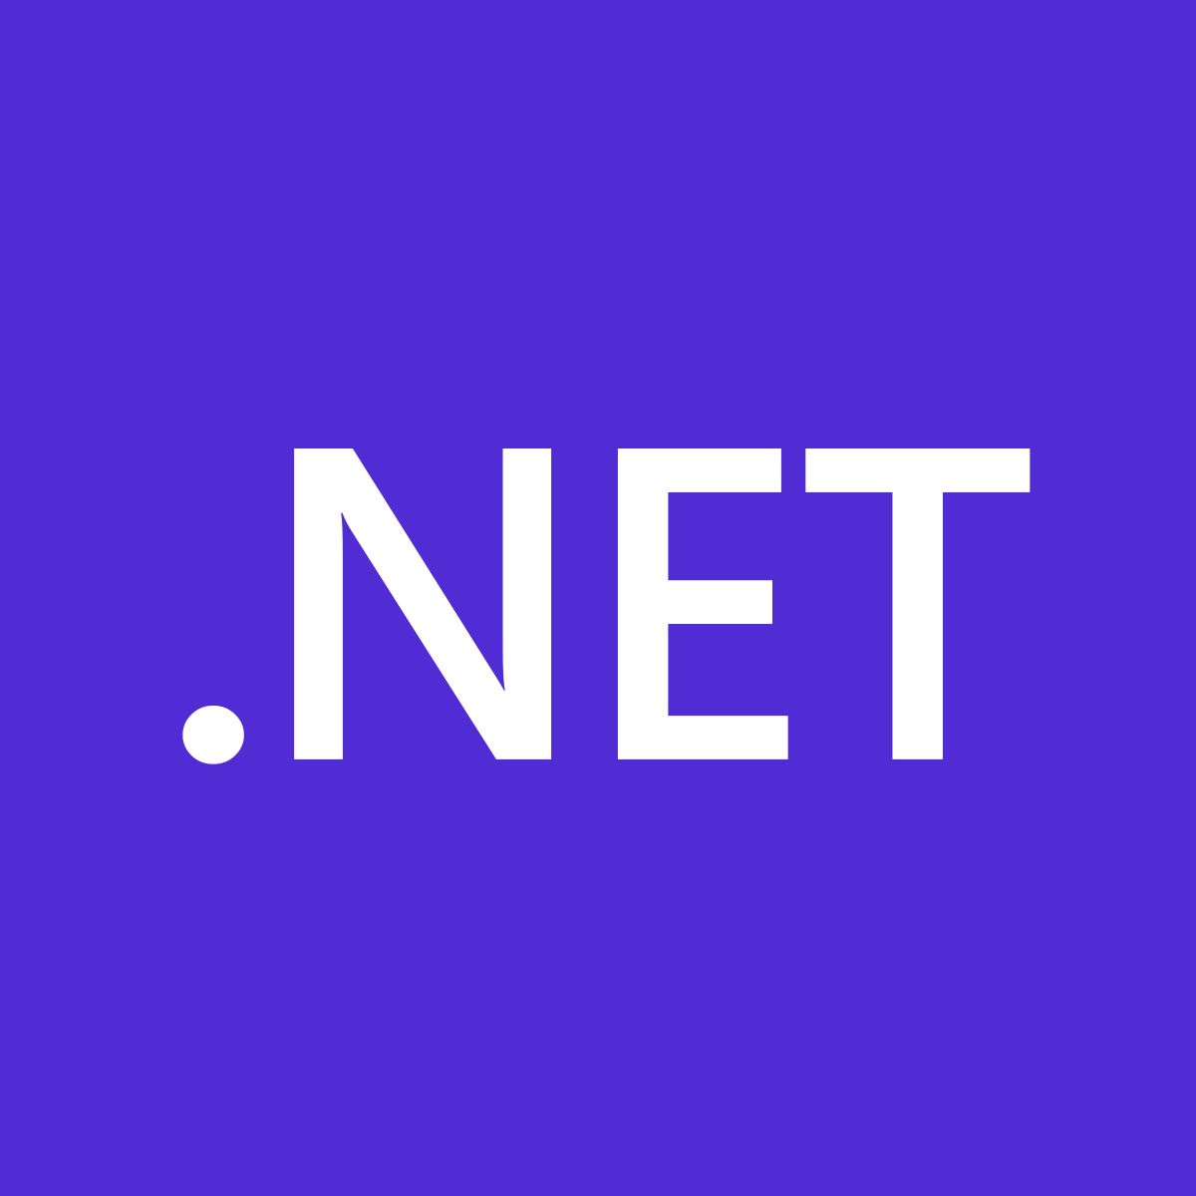
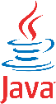





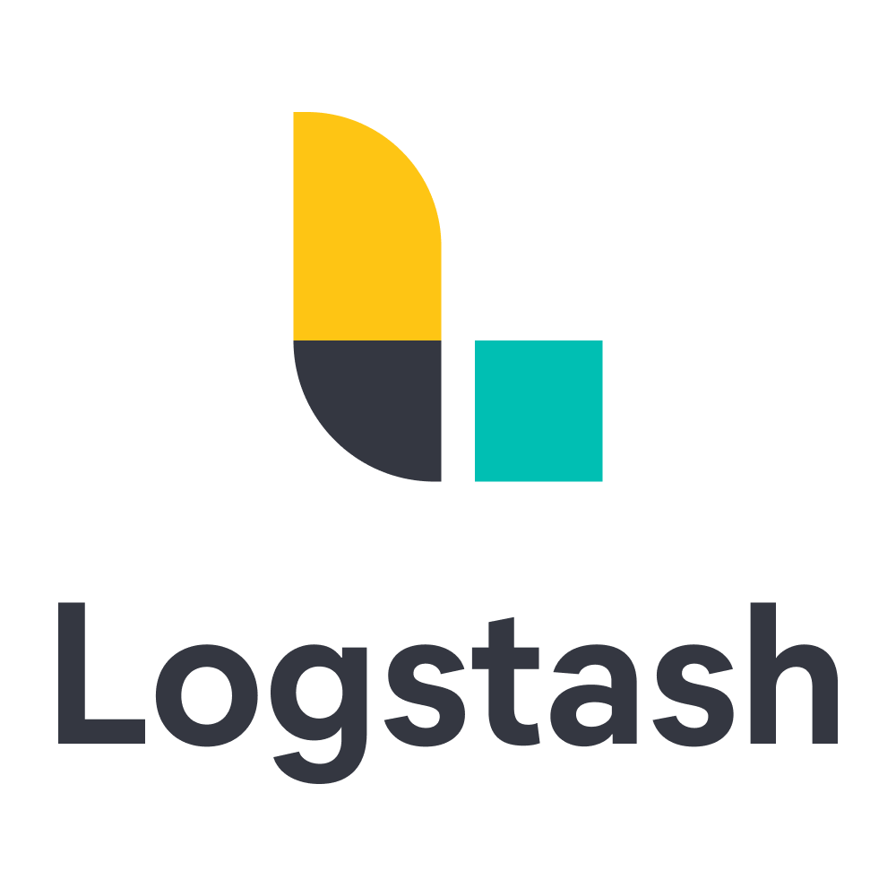
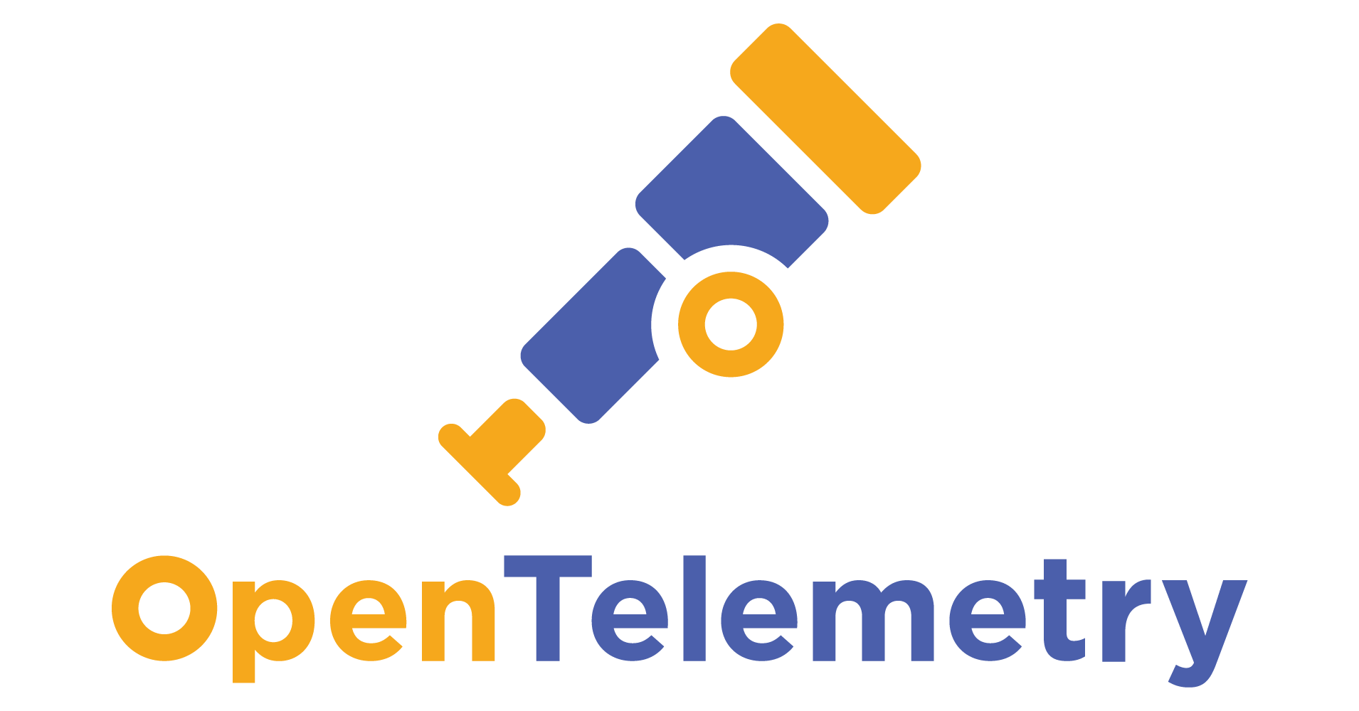
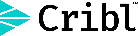
Serilog
Nlog
Notes:
Fabric Eventstreams offers 20+ built-in connectors for cloud services and generic protocols, supporting rapid delivery. These are pull connectors, pull data inside the Eventstream, and you can start applying transformations.
Fabric Eventhouse has connectors, tools, integrations that can pull data. There are also some 3rd party apps that push data to the eventhouse and this is possible depending on the different kind of connectors & partners like Cribl, Splunk, Nlog. Some of these connectors use Java or python or .Net or other languages as the underlying SDK.
All of these SDKs are available if you want to publish dta or push messages to Eventhouse
Open Protocol Support: Fabric supports open protocols such as Kafka, AMQP, ensuring compatibility with telco-specific ecosystems and industry standards. Eventstream exposes Kafka endpoints, allowing clients to send or receive events directly with a Kafka client. This supports KPN’s approach of terminating protocols directly on Kafka for performance and scalability. Integration with Apache Flink and Spark: Eventstreams exposes Kafka topic endpoints that allow engines like Spark and Flink to publish to or consume from Kafka topics, supporting advanced stream processing.
Custom Connector Framework: To avoid long-term lock-in and dependency on vendor development velocity, Fabric Eventstream is building a 'custom connector' capability. This will allow customers like KPN to upload and deploy their own Kafka connectors, extending the platform as needed. The custom connector is currently in the design phase, with public preview timing to be confirmed. What we`ll offer is the capability for you to upload your own connector, we`ll run it, we`ll offer the platform, the machine and the compute resources for you to run your own code as the custom connector.
CDC Support: Fabric supports Change Data Capture (CDC) from databases such as Azure SQL, PostgreSQL, MySQL, Cosmos DB, and SQL Server, enabling real-time synchronization between operational systems and analytical pipelines.
MCP support for RTI and ADX is a full open-source MCP server implementation for Microsoft Fabric Real-Time Intelligence (RTI).
The IoT Hub & EventHub behind the scenes use ASA engine to pull the data and load it in the stream of the eventstream. On the other connectors there are a lot of technologies that are handling the deployment of the process to pull the data, read it and send it to the message system. Being a SAS platform, we abstract this for you so you only need to provide the parameters for the connection and behind the scene it`s going to deploy all resources that are needed to pull data and land it in the message system.

Slide 26






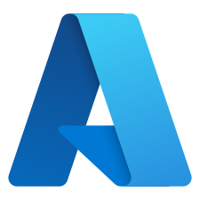
Eventstream | Streaming events
Streams connect to the internal messaging connectors also found in Azure. These are represented as source connectors in the UI in Eventstream.
Depends on the connector, the technology that we use behind the scenes to connect to this sources.
Ex: Event Hub and IoT Hub connector uses Azure Stream Analytics.
Connectors
..and more..
Streams
Workspace &
Capacity events
Blob storage
..and more..
Discrete events
Notes:
WE have stream connectors which are pull connectors that load data inside the stream itself.
Not all connectors use the same technology behind the scenes. EX: IoT Hub & Event Hub use the ASA engine to pull the data & load it in the stream of the EventStream.
The other connectors use other technologies like for example CDC is Debezium, Kafka is Apache Camel. SO we are handling the deployment of this process to pull the data, read the data & send it to the message system, it`s all transparent to the users because we abstract this.
If you have a REST API and want to stream data into Eventstream you`ll need to do it with some kind of a puller, either with spark notebooks or an azure function or a logic app. In Fabric there is no streamer or a puller for a REST API endpoint.

Slide 27
Eventstream | Discrete events
The discrete events from the Fabric workspace and capacity events and the Azure blob storage events are also streamed directly to the internal provisioned EventHub in Eventstream.
Stream
..and more..
Streams
Fabric Events
Activate
Blob storage
..and more..
Discrete events

Slide 28
Eventstream | Discrete events
Stream
Fabric Events
Blob storage
Actions

Slide 29




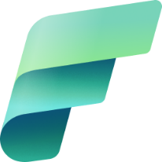




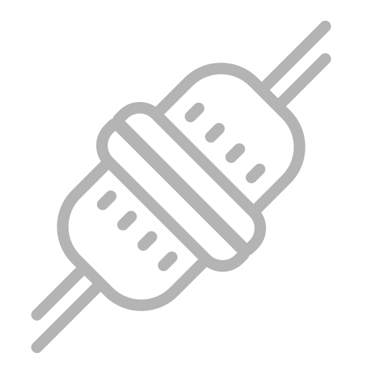

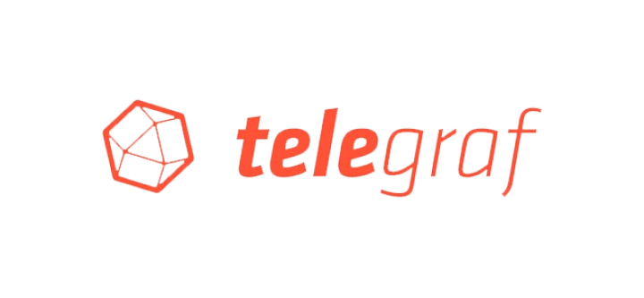
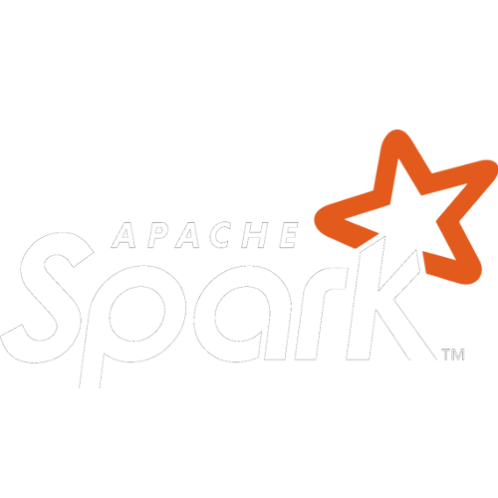




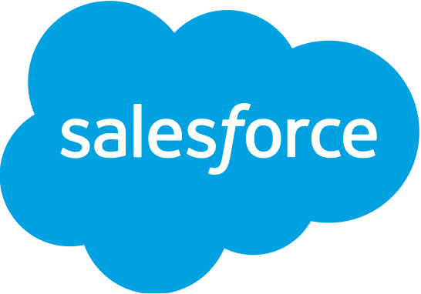
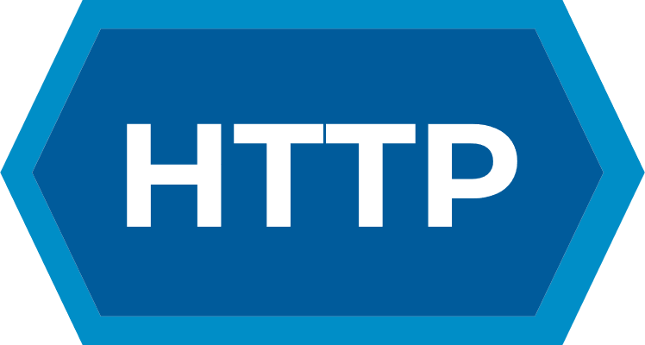


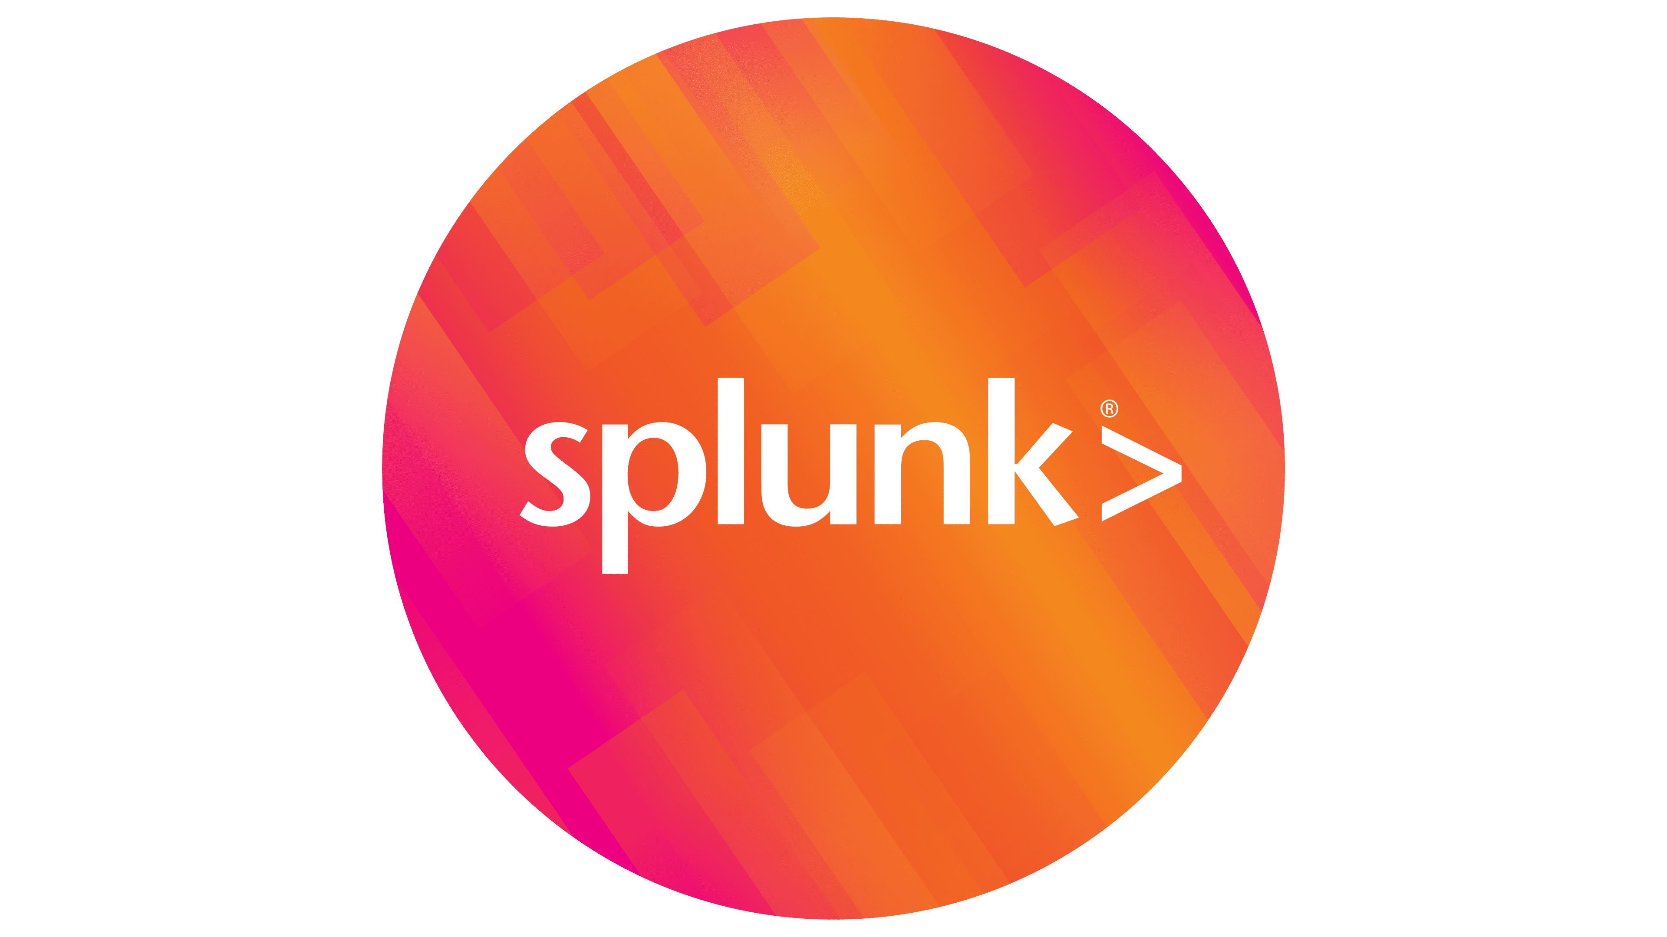

Eventstream | Streaming connectors
Available now
Upcoming
External sources
Apache Kafka
Apache Spark
Apache Flink
MQTT v5
Azure SQL DB CDC
PostgreSQL DB CDC
MySQL DB CDC
Azure Cosmos DB CDC
Azure SQL MI DB CDC
SQL Server on VM DB CDC
Azure Data Explorer
Azure IoT hub
(continued)
Google Cloud Pub/Sub
Confluent Cloud for Apache Kafka
Amazon Kinesis Data Streams
Amazon Managed Streaming for Apache Kafka
Solace PubSub+
Azure Event Hubs
Azure Service Bus
Azure Event Grid Namespace
Real-time weather
OpenTelemetry
Telegraf
(continued)
Splunk Apache Log4j
FluentBit
Logstash
NLog
Serilog
Fabric & Azure events
Fabric Workspace Item events
Fabric Onelake events
Fabric Job events
Azure Blob Storage events
External sources
HTTP
Mongo DB CDC
Oracle DB CDC
Azure blob file stream
MQTT v3.1.1
ServiceNow
OneLake file stream
Salesforce
Delta lake CDF
Eventhouse
Fabric SQL CES
(continued)
JDBC
JIRA
Custom connectors
SAP Hana
Fabric events
Anomaly Detection events
Capacity Utilization events
Business events

Slide 30









Ingest, process, and route events using Eventstream
Eventhouse
Lakehouse
No-code experience
Dashboards
Integration
SQL
Ingestion
SQL for streaming
Processing & Transformation
Rules
Schema Registry & Management
Actions
Sources/Connectors

Slide 31
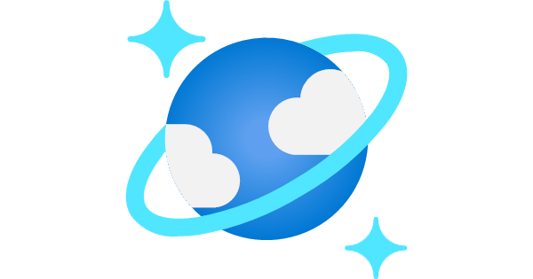
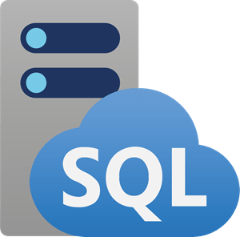
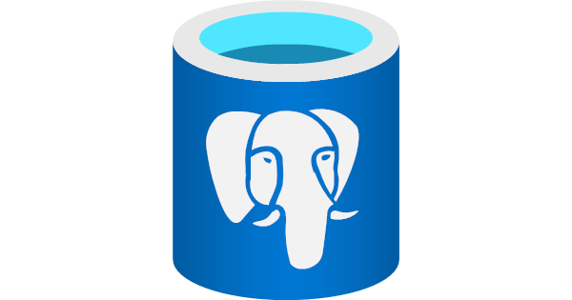


Connect events from many types of sources
Examples of connectors and sources
Change Data
Capture (CDC)
…
CDC for Azure SQL DB
CDC for
Cosmos DB
CDC for Azure SQL MI
CDC for Azure PostgreSQL
CDC for Azure Data Explorer
CDC for SQL Server
CDC for MySQL DB
Message & IoT brokers
…
Azure Service Bus
Solace PubSub+
Google Pub/Sub
MQTT protocol
Azure Event Grid
Azure IoT Hub
Streaming brokers
…
Apache Kafka
AWS Kinesis Data Streams
AWS MSK
Confluent Cloud
Azure Event Hubs
Events
Feeds
OneLake events
Fabric events
…
Weather feed
…
Azure Events

Slide 32
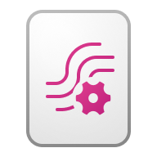

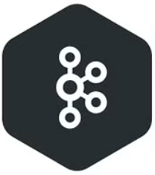
Ingest and egress using open protocols and open source
Eventstream
AMQP
Connectors engine
AMQP
CSV
JSON
Avro
Kafka connect plugin 1
Kafka connect plugin 2
Kafka connect plugin 3
Kafka
…
Kafka
Source connector plugins
KAFKA CONNECT CLUSTER
HTTP
HTTP

Slide 33
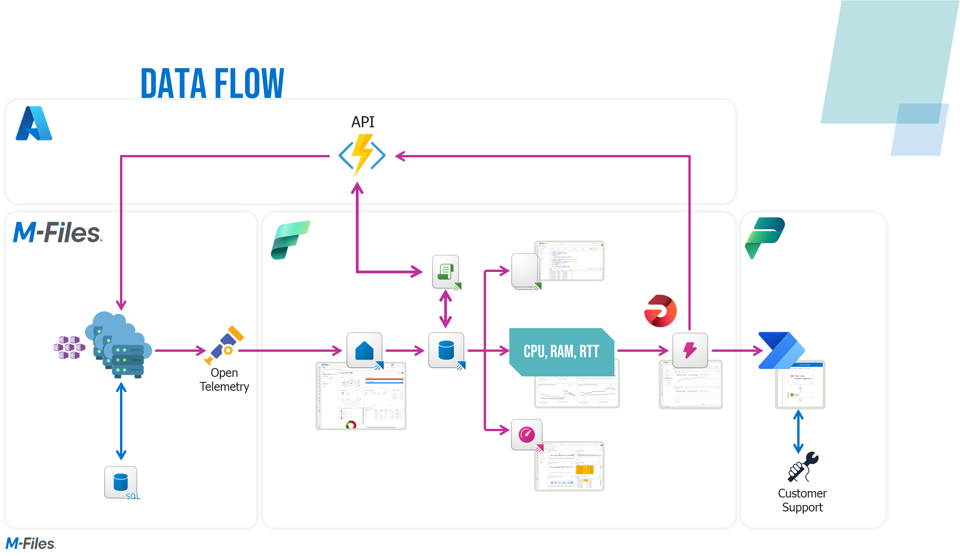
Example of Open Telemetry connector
Notes:
this is an example architecture of a company called mfiles that they created this kind of process to be able to get the logs of the Kubernetes cluster and send it to real time intelligence to do actions.
Why did they did this?
First of all, every time they had a scalable issue or something in the Kubernetes cluster, they need to do it manually.
They need to look at what's happening and they need to change from the virtual cluster to the physical cluster manually with real time.
They use, in this case a product called Open Telemetry that is sending data to the Eventhouse directly. Once it lands there, they are able to react on this data, on metrics like CPU, RAM etc using Activator & it`s going to be able to send a message to Azure Functions to change the container to a different cluster. At the same time it is going to use Power Automate to do some business actions

Slide 34
Ingestion

Slide 35
When ingesting data to the Real-Time Intelligence solution, you have several options.
Using an Eventstream to get data
Direct ingest to the Eventhouse
This module dives into the details of each method and will give you insights to the technical implementation and give you and understanding on how and when to choose what method.
Ingest Into
Eventstream
Ingest Into
Eventhouse

Slide 36
Data Ingestion into Real-Time Ingestion
Real-Time Ingestion and Transformation
Eventstream
Eventhouse
Queued
Ingestion Mappings
Mapping Transforms
Source
Stream
Transformation
Streaming

Slide 37




Eventstream
Event Routing + Processing Engine
Eventhub
Eventhub
Publish to Eventstream
Consume from Eventstream
AMQP
No processing
AMQP
Kafka
Aggregate
Kafka
Expand
Filter
Derived Stream
Eventstream to consume
Manage Fields
Union
Eventhouse
Group by
Delta Lake
Lakehouse
Join
Connectors
Activator
Notes:
Every event stream comes with three endpoints, event hub endpoint, A Kafka endpoint and a AMQP endpoint.
So if you have an application or if you have a source by which you want to publish data to event stream, you can use these endpoints and you can publish data. this is one pattern
The second pattern is to consume data, So we can go and connect to that connector or the data source and consume data from that event stream.
Now when it comes to the stream itself, you can do aggregations, expansions, filters, joins, and also time window analysis like hopping windows, sliding windows, tumbling windows all part of the streaming transformation. If you use the group by operator, you can use those kind of time window analysis.
Now if you want to go out, you have 3 endpoints on the destination where you're consuming applications or some kind of an API or some kind of a service can also consume data from the same 3 endpoints: Eventhub, AMQP, Kafka
So if you have Kafka clusters, Kafka on prem, Kafka in the cloud and you want to keep Kafka and connect to the eventstream and then process data into Fabric, evenstream is 100% Kafka compatible, so whatever source is sending data to Kafka, that source can start sending the same topics to the eventstream.
If it is Apache Kafka, Confluent Kafka, you can also connect to those as well.
From a destination perspective: Derived stream: after you chose a data source, done transformations, you can expose that as a stream that others can consume
Eventhouse
Lakehouse: write data as delta tables. And since you don`t want to write small files because that will create a problem for Spark, you can choose to wait up to a certain size and wait up for certain duration. Those options you choose in the advanced properties that you can configure
Activator: create alerts & actions based on that streaming data

Slide 38
What’s behind an Eventstream?
Sources
Stream
Transformational
Destinations
Custom Endpoint
Connected Sources
Sample Data
Under the hood Eventhub
Aggregate
Expand
Filter
Manage Fields
Union
Group By
Join
Under the hood stream analytics jobs
Custom Endpoint
Derived Stream
Eventhouse
Direct (w/o transformation)
Event processing before ingestion
Lakehouse
Activator
(Optional)
Notes:
what is behind an event stream:So you have different sources, custom endpoint, connected sources and sample data.
When you create a stream, it is creating an event hub for you, behind the scenes
When you transform data, these are stream analytics cost
Everytime you use a connector, it has cost associated with it & consumes CU
Fixed cost for the Eventstream, 0.222 Cus per hour
Transformations will create processing unit, 0.786 Cus per processing units
Destinations: Derived stream is a new cost

Slide 39
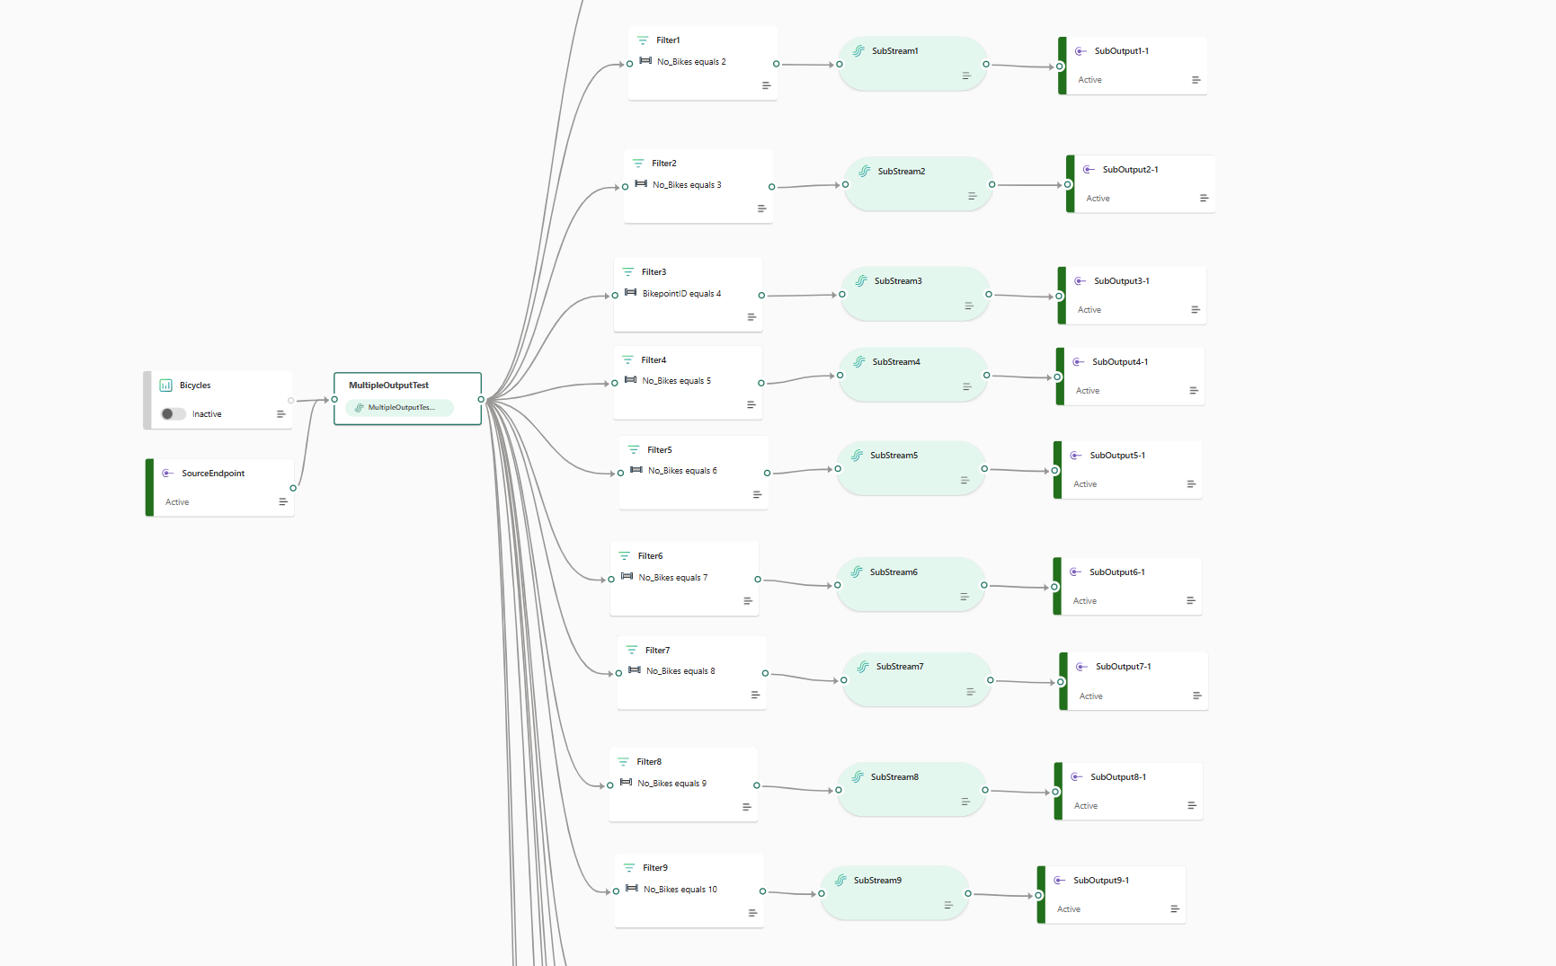

Slide 40
How does Evenstream treat multiple routing and transformation paths?
Processing Job 1
Transformation Node 1
Transformation Node 2
Destination 1
Processing Job 2
Source
Transformation Node A
Transformation Node B
Destination 2
Processing Job 3
Transformation Node I
Destination 3
Notes:
You`ve seen different ingestion methods, how do we treat it in terms of processing or how do we treat it in terms of cost
So if you have created one event stream source, which is doing three types of transformations or five types of transformations going to three different destinations, then each branch is treated as one job.
so you're gonna be charged for each processing unit.
So these are 3 different processing units, per destination, not per job. So it`s not 5 jobs because there are 5 transformations you are dong here.
So keep in mind when you`re thinking about cost, the processing job is per destination, you can have as many transformations as you want.

Slide 41
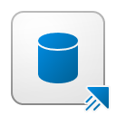
Eventstream Ingestion Modes
Push
Eventstream sends data to the Eventhouse (push) and/or to the Lakehouse in Fabric
Lakehouse
Eventstream
Pull
Eventhouse can pull the data from the Eventstream using Direct Ingestion
Eventhouse
Notes:
when we talk about event stream ingestion modes, there are two modes: Push & Pull
when we talk about push, we are writing data to a lake house as a delta table.
With Eventhouse you have both push & pull. When choosing an eventhouse as a destination, you can choose to do event processing before ingestion(push) or direct ingestion(pull).
So when you are applying all those transformations like expansion or managed fields or filters etcetera, then it is event processing before. So you're processing the event, processing the message before you're going to store the message in event house that is a push mode
Your event stream is processing all the messages and then it's gonna write the message to an event house table.
In pull mode, the eventhouse has a capability of reading events from a particular source and that is a pull mode, where you have low latencies. In push mode, latency is about 20s.

Slide 42

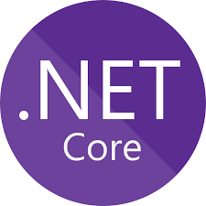


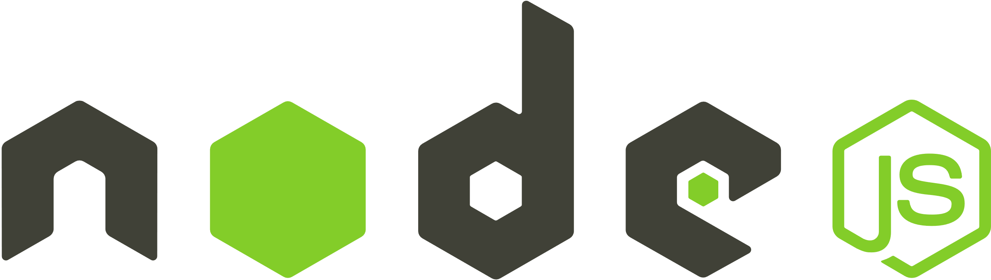


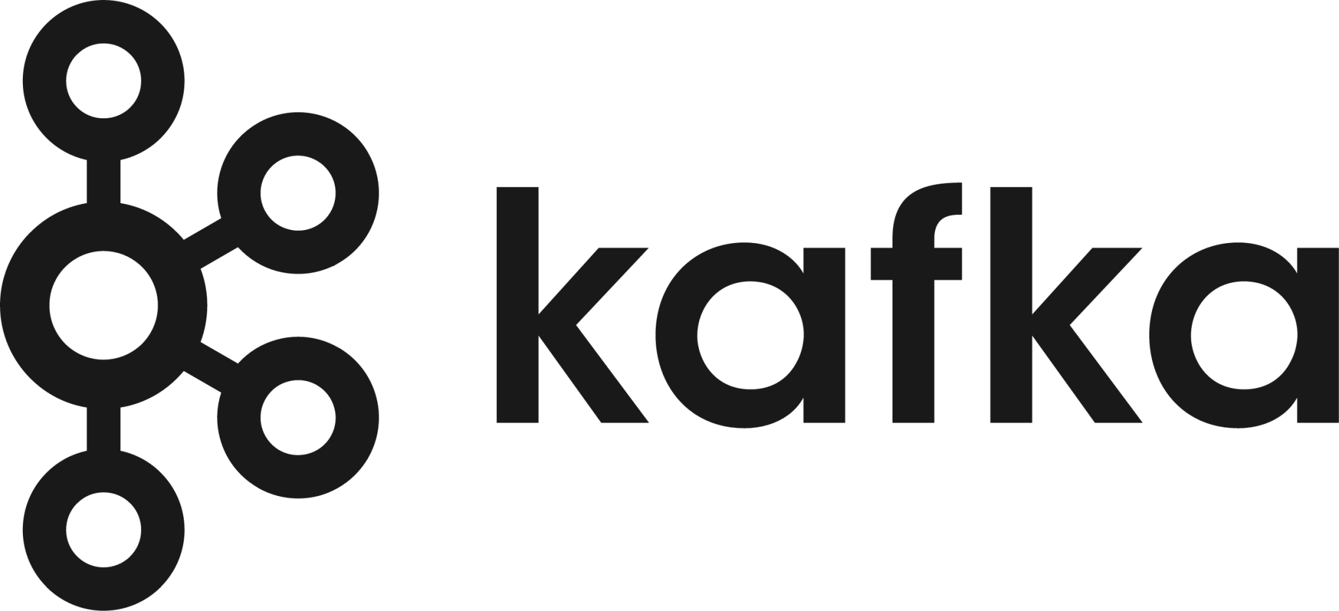
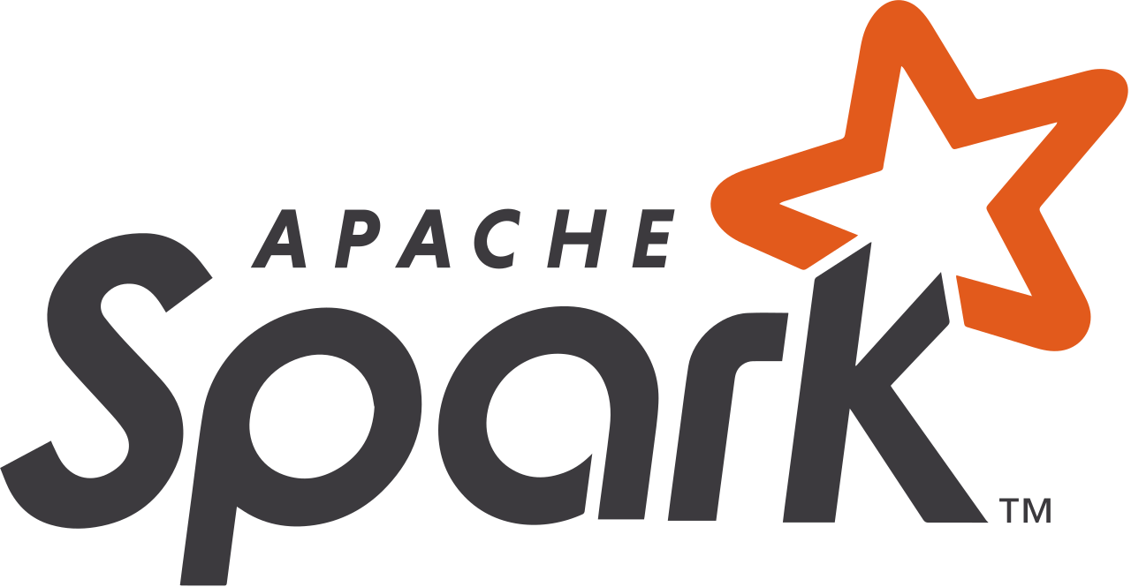
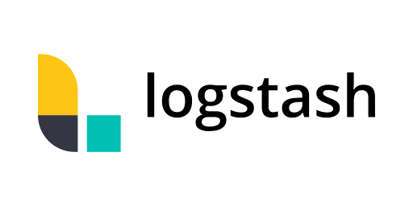

Ingestion into Eventhouse: Queued Ingestion
SDKs
Eventhouse
Azure Sources
Data Stream
Batching
Data Management
Ingestion
Eventhouse (Kusto Engine)
Connection & Plugins
Management
Notes:
Eventhouse under the hood, had 2 sets of computes, 1 is called data management compute 2nd is the engine compute,
1.Data Management Compute: connects to different streams, reads data and prepares data to be pushed to the engine
2.Engine compute is doing partitioning, indexing, compressing and serving as a query gateway and query serving
Those are the purposes of the 2 computes, this is transparent to the users, but that is how the separation of compute between ingestion & querying is happening and that is how we scale out independently and serve volumes you need.
When we talk about data management, when you connect to an eventstream, we create a data stream and the data management part of the engine will start writing data to the engine saying this is the amount of messages i`ve received, store these in a table and the data management engine will do the job of storing that data. And this is how ingestion works in the Eventhouse.
When we talk about ingestion, there are 2 modes:

Slide 43
Queued Ingestion
Queued ingestion performs data batching and is optimized for high ingestion throughput.
This is the preferred and most performant ingestion method.
Data is batched according to ingestion properties.
Small batches results in small extents. These extents will be later merged to larger extents, optimized for fast query results.
Batching policy
Defined on cluster / database / table, inherited
alter database Metrics policy ingestionbatching @'{"MaximumBatchingTimeSpan":"00:00:30", "MaximumNumberOfItems": 500, "MaximumRawDataSizeMB": 1024}'
Sealing batch by time / size / number of sources limits
If not defined, default values are applied
Notes:
Think of it like batch ingestion or micro batch ingestion.
Remember the fact that you can specify how you want it to manage the queue by defining a batching time span, like collect messages up to 30s or collect 500messages & write it, or collect messages up to 1GB and then write it( see next slide)
What we are doing in queued ingestion is event house under the hood has a hidden queue. So all the messages that we are reading from multiple different sources, will be queued and then all those queues will be processed by the data management engine and written to the the kusto engine.
And that queuing will depend on your ingestion batching policy. You can define 1,2,3 conditions like in this example, whichever condition is met first then ingestion starts.
Default cluster ingestion batching policy is 5 minutes, 1000 items and 1024 MBs
When to choose ingestion with Eventstream vs Eventhouse? Think about the fact that Eventhouse has diff connectors, you can`t connect to Google PubSub, AWS Kinesis, CDC etc. Also, the queue in Eventhouse is smaller than the eventstream, eventstream gives you more capabilities: store up to 1 day of data, retain one day of data and you can process it at much higher volumes & speed. And you get it oob with Eventstream. Also, time window analysis with hopping windows, sliding windows etc can only be done in EVentstream.

Slide 44
Ingestion into Eventhouse: Stream Ingestion
SDKs
Eventhouse
Azure Sources
Eventhouse (Kusto Engine)
Connection & Plugins
Notes:
In queued ingestion a message size can be 1 GB, so you can push like a big message and it will process it.
In streaming ingestion, the message size can only be 4 megabytes.
so if you want us to do super low latency streaming ingestion, then you have to keep the message size low because that's what we can process very quickly.

Slide 45
Streaming Ingestion
KQL
//create table
.create table TestTable (TimeStamp:datetime, Name:string, Metric:int, Source:string)
//define table policy
.alter table TestTable policy streamingingestion enable
//define database policy
.alter database StreamingTestDb policy streamingingestion enable
//control command
.show table MyTable policy streamingingestion
Notes:
When you create a new event house, it's by default streaming enabled, if you don`t want it, you have policies in order to disable that streaming.
And you can define this at event house level or you can define it per table as well.
So you can have some table in queued, some table in streaming.

Slide 46
Queued vs streaming ingestion
Queued
Optimized for high ingestion throughput
Preferred method and most performant
Data is batched according to properties
Set ingestion batching policy on databases or tables
Default max batching value is 5 minutes, 1000 items or total of 1 GB
4 GB data size limit for a batch ingestion command
Streaming
Ongoing data ingestion from a streaming source
Near real-time latency for small sets of data per table
Initially ingested to row store
Then moved to column store extents
Steaming can be done using Eventhouse client library or supported pipelines
NOTE: The recommendation is to ingest files between 100 MB and 1 GB.
Notes:
Event House supports 2 modes of ingestion, queued ingestion and streaming ingestion.
In queued ingestion a message size can be 1 GB, so you can push like a big message and it will process it.
In streaming ingestion, the message size can only be 4 megabytes.
With streaming ingestion, I have personally experienced latencies of about 85 milliseconds, 100 milliseconds, that is how fast it can go in terms of processing data & query it

Slide 47
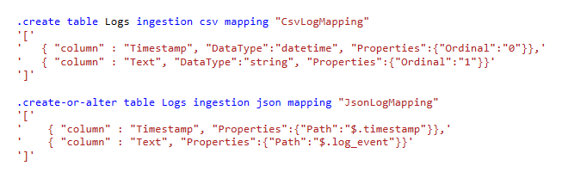
Data Formats and Mapping
Data formats
Text, Raw
Delimiter separated values: CSV, TSV, TSVE, PSV, SCSV, SOH
JSON (line-separated, multiline)
Avro, Parquet, ORC
Supports ZIP and GZIP compression
Column Mapping
Rename, reorder, or skip fields
CSV mapping maps field ordinals to columns
JSON and Avro mappings map field paths to columns
Notes:
OK then in terms of data formats and mapping events, Evenstream supports CSV, JSON and Avro.
Eventhouse supports more formats
But for example, if you if you have zipped data or compressed data, because some sources can send compressed data zipped or gzipped, you can decompress that data.
Neither eventhouse or eventstream can handle binary today

Slide 48

Ingest SDKs
Ingest client libraries are used for performing queued ingestion.
Data is uploaded to a blob and a message is posted to the Data Management service queue.
The message contains reference to the blob, mandatory ingestion properties (Database, Table) and optional ingestion properties (Format, IngestionMapping etc.)
SDKs
.NET Standard
Python
Node.js
Java
REST API
Go
Notes:
All these SDKS are available if you want to publish data or push messages to event house.
This is especially in your applications, If you want to send data, publish data, then that's where it would apply.

Slide 49
Ingestion mapping
The KQL database can directly ingest data from the outside to the database. This is done by using custom connectors to external tables and plugins from the library of plugins.
When importing data from file structures (csv, avro, json, etc) the ingestion mapping can be used to map the source to the destination.
The following ingestion mappings are available:
TXT Mapping
CSV
TSV
TSVe
PSV
SCSV
SOHsv
TXT
RAW
JSON
AVRO
Parquet
ORC
W3LogFile
Apache AVRO
Parquet Mapping
ORC Mapping
W3LogFile Mapping
Avro Mapping
Notes:
Because we because you can support all these different formats in in event house, depending on the format, it will automatically interpret the schema and assign the appropriate data types.
So if it is a supported format, we can do all the mapping to the different columns, column names, column types, etc. This is all done for you based on based on the schema that we discover and the format that we interpret.

Slide 50
Ingestion mapping
Mappings can be paired to a single ingestion or created as a reusable mapping between different ingestions. Though to the same destination table only.
Source
Mapping
Table
1:1 mapping
Source
Source
Mapping
Table
1:M mapping
Source
Notes:
You can do 1:1 mapping or 1:m mapping, So it depends on how you want to process it, what different tables you want to assign it to.
You can do that depending on the different sources you can apply the same mapping. So all the different data will land into the same table.

Slide 51
Mapping transformations
Some of the data format mappings (Parquet, JSON, and AVRO) support simple and useful ingest-time transformations. Where the scenario requires more complex processing at ingest time, use Update policy, which allows defining lightweight processing using KQL expression.
PropertyBagArrayToDictionary
SourceLineNumber
DateTimeFromUnixSeconds
SourceLocation
DateTimeFromUnixNanoseconds
BytesAsBase64
DateTimeFromUnixMicroseconds
DropMappedFields
DateTimeFromUnixMilliseconds
Notes:
You also have some mapping transformation.
So a lot of time in barch data you will land the data and then do some data deciphering
So you don't have to land that data, then run something to convert that data into a in a friendly format.
So you can do these transformations again as part of ingestion and not after landing the data.

